Slide 1
COST VOLUME PROFIT ANALYSIS
Md. Amjad Hossain

Slide 2
Basics of CVP Analysis
Cost-volume-profit (CVP) analysis is a key step in many decisions. CVP analysis involves specifying a model of the relations among the prices of products, the volume or level of activity, unit variable costs, total fixed costs, and the sales mix. This model is used to predict the impact on profits due to changes in those parameters.
Notes:
Quite frequently, it is necessary to predict how a certain cost will behave in response to a change in activity. For example, a manager may want to estimate the impact that a 5% increase in sales would have on the company’s total electric bill. Cost behavior refers to how a cost will react to changed in the level of activity within the relevant range. The most commonly used classifications of cost behavior are variable and fixed costs.

Slide 3
Basics of CVP Analysis (contd.)
Contribution Margin. Contribution margin is the amount remaining from sales revenue after variable expenses have been deducted. It contributes towards covering fixed costs and then towards profit.
Unit Contribution Margin. The unit contribution margin can be used to predict changes in total contribution margin as a result of changes in the unit sales of a product.

Slide 4
Basics of CVP Analysis (contd.)
Contribution Margin Ratio. The contribution margin (CM) ratio is the ratio of the contribution margin to total sales.
The contribution margin ratio is often easier to work with than the unit contribution margin, particularly when a company has many products.

Slide 5
Uses of CVP Analysis
What is the firm’s break-even-point?
What level of sales must be achieved to earn a satisfactory amount of net income?
How will sales volume be affected if selling prices are increased or decreased?
What will be the impact on profits of a variable cost being replaced by a fixed cost?
What is the most profitable sales mix?
Notes:
Quite frequently, it is necessary to predict how a certain cost will behave in response to a change in activity. For example, a manager may want to estimate the impact that a 5% increase in sales would have on the company’s total electric bill. Cost behavior refers to how a cost will react to changed in the level of activity within the relevant range. The most commonly used classifications of cost behavior are variable and fixed costs.

Slide 6
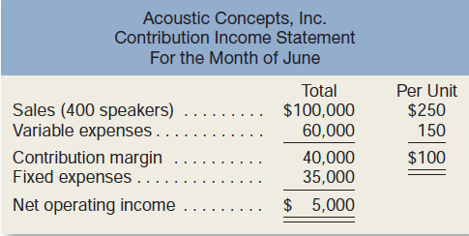
Contribution Income Statement
Notes:
Quite frequently, it is necessary to predict how a certain cost will behave in response to a change in activity. For example, a manager may want to estimate the impact that a 5% increase in sales would have on the company’s total electric bill. Cost behavior refers to how a cost will react to changed in the level of activity within the relevant range. The most commonly used classifications of cost behavior are variable and fixed costs.

Slide 7
Contribution Income Statement
Contribution Margin (CM) is the amount remaining from sales revenue after variable expenses have been deducted.
Notes:
Quite frequently, it is necessary to predict how a certain cost will behave in response to a change in activity. For example, a manager may want to estimate the impact that a 5% increase in sales would have on the company’s total electric bill. Cost behavior refers to how a cost will react to changed in the level of activity within the relevant range. The most commonly used classifications of cost behavior are variable and fixed costs.

Slide 8
Contribution Income Statement
CM is used first to cover fixed expenses. Any remaining CM contributes to net operating income.
Notes:
Quite frequently, it is necessary to predict how a certain cost will behave in response to a change in activity. For example, a manager may want to estimate the impact that a 5% increase in sales would have on the company’s total electric bill. Cost behavior refers to how a cost will react to changed in the level of activity within the relevant range. The most commonly used classifications of cost behavior are variable and fixed costs.

Slide 9
Contribution Income Statement
Sales, variable expenses, and contribution margin can also be expressed on a per unit basis. For sale of each additional speaker, $100 additional CM will be generated to cover fixed expenses and profit.
Notes:
Quite frequently, it is necessary to predict how a certain cost will behave in response to a change in activity. For example, a manager may want to estimate the impact that a 5% increase in sales would have on the company’s total electric bill. Cost behavior refers to how a cost will react to changed in the level of activity within the relevant range. The most commonly used classifications of cost behavior are variable and fixed costs.

Slide 10
Expressing CVP Relationships
The equation method;
The contribution margin method;
The graph method;
Notes:
Quite frequently, it is necessary to predict how a certain cost will behave in response to a change in activity. For example, a manager may want to estimate the impact that a 5% increase in sales would have on the company’s total electric bill. Cost behavior refers to how a cost will react to changed in the level of activity within the relevant range. The most commonly used classifications of cost behavior are variable and fixed costs.

Slide 11
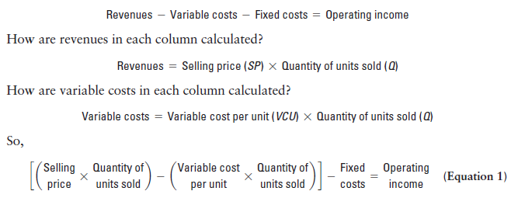
The equation method
Notes:
Quite frequently, it is necessary to predict how a certain cost will behave in response to a change in activity. For example, a manager may want to estimate the impact that a 5% increase in sales would have on the company’s total electric bill. Cost behavior refers to how a cost will react to changed in the level of activity within the relevant range. The most commonly used classifications of cost behavior are variable and fixed costs.

Slide 12
Equation Method
Profits = (Sales – Variable expenses) – Fixed expenses
OR
Sales = Variable expenses + Fixed expenses + Profits
At the break-even point
profits equal zero
Notes:
The equation method is based on the contribution approach income statement. The equation can be stated in one of two ways:
Profits equal Sales less Variable expenses, less Fixed Expenses, or
Sales equal Variable expenses plus Fixed expenses plus Profits Remember that at the break-even point profits are equal to zero.

Slide 13
Equation Method
We calculate the break-even point as follows:
Sales = Variable expenses + Fixed expenses + Profits
$250Q = $150Q + $35,000 + $0
Where:
Q = Number of bikes sold
$250 = Unit selling price
$150 = Unit variable expense
$35,000 = Total fixed expense
Notes:
The break-even point in units is determined by creating the equation as shown, where Q is the number of bikes sold, $500 is the unit selling price, $300 is the unit variable expense, and $80,000 is the total fixed expense. We need to solve for Q.

Slide 14
Equation Method
We calculate the break-even point in units as follows:
Sales = Variable expenses + Fixed expenses + Profits
$250Q = $150Q + $35,000 + $0
$250Q - $150Q = $35,000
$100Q = $35,000
Q = $35,000 ÷ $100 per bike
Q = 350 bikes
Notes:
Solving this equation shows that the break-even point in units is 400 bikes. We want to be careful with the algebra when we group terms.

Slide 15
Equation Method
The equation can be modified to calculate the break-even point in sales dollars.
Sales = Variable expenses + Fixed expenses + Profits
X = 0.60X + $35,000 + $0
Where:
X = Total sales dollars
0.60 = Variable expenses as a % of sales $35,000 = Total fixed expenses
Notes:
The equation can be modified as shown to calculate the break-even point in sales dollars. In this equation, X is total sales dollars, point six zero (or 60%) is the variable expense as a percentage of sales, and $80,000 is the total fixed expense. We need to solve for X.

Slide 16
Equation Method
The equation can be modified to calculate the break-even point in sales dollars.
Sales = Variable expenses + Fixed expenses + Profits
X = 0.60X + $35,000 + $0
0.40X = $35,000
X = $35,000 ÷ 0.40
X = $87,500
Notes:
Solving this equation shows that the break-even point is sales dollars is $200,000. Once again, be careful when you combine the X values in the equation.

Slide 17
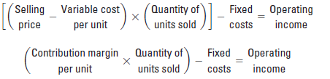
The contribution margin method
Notes:
Quite frequently, it is necessary to predict how a certain cost will behave in response to a change in activity. For example, a manager may want to estimate the impact that a 5% increase in sales would have on the company’s total electric bill. Cost behavior refers to how a cost will react to changed in the level of activity within the relevant range. The most commonly used classifications of cost behavior are variable and fixed costs.

Slide 18
Contribution Margin Method
The contribution margin method has two key equations.
Break-even point
in units sold
Fixed expenses CM per unit
=
Break-even point in
total sales dollars
Fixed expenses
CM ratio
=
Notes:
The contribution margin method has two key equations: Break-even point in units sold equals Fixed expenses divided by CM per unit, and
Break-even point in sales dollars equals Fixed expenses divided by CM ratio.

Slide 19
Contribution Margin Ratio
The contribution margin ratio is: For Acoustic Concepts the ratio is:
Total CM
Total sales
CM Ratio =
$40,000
$100,000
= 40%
Each $1.00 increase in sales results in a total contribution margin increase of 40¢.
Notes:
We can calculate the contribution margin ratio of Racing Bicycle by dividing total contribution by total sales. In the case of Racing Bicycle, the contribution margin ratio is 40%. This means that for each dollar increase in sales the company will produce 40¢ in contribution margin.

Slide 20
Contribution Margin Ratio
Or, in terms of units, the contribution margin ratio is: For Acoustic Concept the ratio is:
Unit CM
Unit selling price
CM Ratio =
$100
$250
= 40%
Notes:
The CM ratio can also be calculated by dividing the contribution margin per unit by the selling price per unit.

Slide 21
Contribution Margin Method
Let’s use the contribution margin method to calculate the break-even point in total sales dollars.
Break-even point in
total sales dollars
Fixed expenses
CM ratio
=
$35,000
40%
= $87,500 break-even sales
Notes:
Part I
Let’s use the contribution margin method to calculate break-even in total sales dollars.
Part II
The break-even sales revenue is $200,000.

Slide 22
The Contribution Approach
We do not need to prepare an income statement to estimate profits at a particular sales volume. Simply multiply the number of units sold above break-even by the contribution margin per unit.
If the firm sells 380 speakers, its net income will be $3,000.
Notes:
If we develop equations to calculate break-even and net income, we will not have to prepare an income statement to determine what net income will be at any level of sales. For example, we know that if Racing Bicycle sells four hundred thirty bikes, net income will be $6,000. The company will sell 30 bikes above the break-even unit sales and the contribution margin is $200 per bike. So, we multiply 30 bikes times $200 per bike and get net income of $6,000.

Slide 23
Graph Method
The relationship among revenue, cost, profit and volume can be expressed graphically by preparing a CVP graph. Racing developed contribution margin income statements at 300, 400, and 500 units sold. We will use this information to prepare the CVP graph.
Notes:
The relationship among revenue, cost, profit and volume can be expressed graphically by preparing a cost-volume-profit (CVP) graph. To illustrate, we will use contribution income statements for Racing Bicycle Company at 300, 400, and 500 units sold.

Slide 24
CVP Graph
Dollars
In a CVP graph, unit volume is usually represented on the horizontal (X) axis and dollars on the vertical (Y) axis.
Units
Notes:
In a CVP graph, unit volume is usually represented on the horizontal (X) axis and dollars on the vertical (Y) axis. Using this convention, a CVP graph can be prepared in three steps.

Slide 25
CVP Graph
Dollars
Fixed Expenses
Units
Notes:
The first step begins by drawing a line parallel to the volume axis to represent total fixed expenses of $80,000.

Slide 26
CVP Graph
Dollars
Total Expenses
Fixed Expenses
Units
Notes:
Next, choose some sales volume (for example, 500 units) and plot the point representing total expenses (e.g., fixed and variable) at that sales volume. Draw a line through the data point back to where the fixed expenses line intersects the dollar axis.

Slide 27
CVP Graph
Total Sales
Dollars
Total Expenses
Fixed Expenses
Units
Notes:
Finally, choose some sales volume (for example, 500 units) and plot the point representing total sales dollars at the chosen activity level. Draw a line through the data point back to the origin.

Slide 28
CVP Graph
Break-even point (400 units or $200,000 in sales)
Profit Area
Dollars
Loss Area
Units
Notes:
The break-even point is where the total revenue and total expenses lines intersect. In the case of Racing Bicycle, break-even is 400 bikes sold, or sales revenue of $200,000. The profit or loss at any given sales level is measured by the vertical distance between the total revenue and the total expenses lines.

Slide 29
Change in Fixed Cost, Sales Price and Volume
What is the profit impact if Racing (1) cuts its selling price $20 per unit, (2) increases its advertising budget by $15,000 per month, and (3) increases sales from 500 to 650 units per month?
Notes:
Here is a more complex situation. What is the profit impact if RBC: (1) cuts its selling price $20 per unit, (2) increases its advertising budget by $15,000 per month, and (3) increases sales from 500 to 650 units per month?

Slide 30
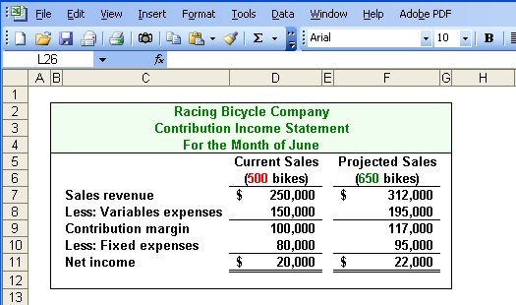
Change in Fixed Cost, Sales Price and Volume
Sales increase by $62,000, fixed costs increase by $15,000, and net operating income increases by $2,000.
Notes:
This appears to be a good plan because net income will increase by $2,000. Take a few minutes and analyze the change in sales revenue, variable expenses and fixed expenses.

Slide 31
Change in Variable Cost, Fixed Cost and Sales Volume
What is the profit impact if Racing (1) pays a $15 sales commission per bike sold instead of paying salespersons flat salaries that currently total $6,000 per month, and (2) increases unit sales from 500 to 575 bikes?
Notes:
Here is another complex question involving cost-volume-profit relationships. What is the profit impact if RBC: (1) pays a $15 sales commission per bike sold instead of paying salespersons flat salaries that currently total $6,000 per month, and (2) increases unit sales from 500 to 575 bikes?

Slide 32
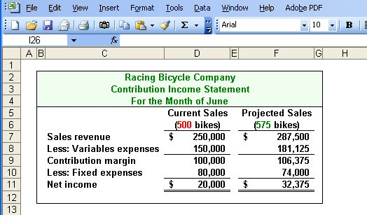
Change in Variable Cost, Fixed Cost and Sales Volume
Sales increase by $37,500, variable costs increase by $31,125, but fixed expenses decrease by $6,000.
Notes:
Net income increased by $12,375. Notice that sales revenue and variable expenses increased as well. Fixed expenses were decreased as a result of making sales commissions variable in nature. How did you do? We hope you are beginning to see the potential power of CVP analysis.

Slide 33
Change in Regular Sales Price
If Racing has an opportunity to sell 150 bikes to a wholesaler without disturbing sales to other customers or fixed expenses, what price would it quote to the wholesaler if it wants to increase monthly profits by $3,000?
Notes:
Suppose RBC has a one-time opportunity to sell 150 bikes to a wholesaler. There would be no change in the cost structure as a result of this sale. Racing wants the one-time sale to produce a profit of $3,000. What selling price should RBC quote to the wholesaler?

Slide 34
Change in Regular Sales Price
Notes:
If we desire a profit of $3,000 on the sale of 150 bikes, we must have a profit of $20 per bike. The variable expenses associated with each bike are $300, so we would quote a selling price of $320. You can see the proof of the quote in the blue schedule.

Slide 35
Quick Check ✓
Coffee Klatch is an espresso stand in a downtown office building. The average selling price of a cup of coffee is $1.49 and the average variable expense per cup is $0.36. The average fixed expense per month is $1,300. How many cups of coffee would have to be sold to attain target profits of $2,500 per month?
a. 3,363 cups
b. 2,212 cups
c. 1,150 cups
d. 4,200 cups
Notes:
The Coffee Klatch wants to earn a monthly profit of $2,500. How many cups of coffee must the company sell to reach this profit goal?

Slide 36
Quick Check ✓
Unit sales to attain target profit
Fixed expenses + Target profit
Unit CM
=
Coffee Klatch is an espresso stand in a downtown office building. The average selling price of a cup of coffee is $1.49 and the average variable expense per cup is $0.36. The average fixed expense per month is $1,300. How many cups of coffee would have to be sold to attain target profits of $2,500 per month?
a. 3,363 cups
b. 2,212 cups
c. 1,150 cups
d. 4,200 cups
$1,300 + $2,500
$1.49 - $0.36
=
$3,800
$1.13
=
= 3,363 cups
Notes:
We add the desired profit to the fixed cost and divide by the unit contribution of $1.13. The company must sell 3,363 cups of coffee to reach its profit goal.

Slide 37
The Margin of Safety
The margin of safety is the excess of budgeted (or actual) sales over the break-even volume of sales.
Margin of safety = Total sales - Break-even sales
Let’s look at Racing Bicycle Company and determine the margin of safety.
Notes:
The margin of safety helps management assess how far above or below the break-even point the company is currently operating. To calculate the margin of safety, we take total current sales and subtract break-even sales. Let’s calculate the margin of safety for RBC.

Slide 38
The Margin of Safety
If we assume that Racing Bicycle Company has actual sales of $250,000, given that we have already determined the break-even sales to be $200,000, the margin of safety is $50,000 as shown.
Notes:
RBC is currently selling 500 bikes and producing total sales revenue of $250,000. Sales at the break-even point are $200,000, so the company’s margin of safety is $50,000.

Slide 39
The Margin of Safety
The margin of safety can be expressed as 20% of sales. ($50,000 ÷ $250,000)
Notes:
We can express the margin of safety as a percent of sales. In the case of RBC, the margin of safety is 20% ($50,000 divided by $250,000).

Slide 40
The Margin of Safety
The margin of safety can be expressed in terms of the number of units sold. The margin of safety at Racing is $50,000, and each bike sells for $500.
Margin of Safety in units
$50,000 $500
=
= 100 bikes
Notes:
The margin of safety can be expressed in terms of the number of units sold. RBC’s margin of safety is 100 bikes.

Slide 41
Quick Check ✓
Coffee Klatch is an espresso stand in a downtown office building. The average selling price of a cup of coffee is $1.49 and the average variable expense per cup is $0.36. The average fixed expense per month is $1,300. 2,100 cups are sold each month on average. What is the margin of safety?
a. 3,250 cups
b. 950 cups
c. 1,150 cups
d. 2,100 cups
Notes:
Let’s see if you can calculate the margin of safety in cups of coffee for the Coffee Klatch.

Slide 42
Quick Check ✓
Coffee Klatch is an espresso stand in a downtown office building. The average selling price of a cup of coffee is $1.49 and the average variable expense per cup is $0.36. The average fixed expense per month is $1,300. 2,100 cups are sold each month on average. What is the margin of safety?
a. 3,250 cups
b. 950 cups
c. 1,150 cups
d. 2,100 cups
Margin of safety = Total sales – Break-even sales
= 2,100 cups – 1,150 cups
= 950 cups
or
Margin of safety percentage
950 cups
2,100 cups
=
= 45%
Notes:
The margin of safety is 950 cups, or we can calculate the margin of safety as 45%.

Slide 43
Operating Leverage
A measure of how sensitive net operating income is to percentage changes in sales.
Degree of
operating leverage
Contribution margin
Net operating income
=
Notes:
The degree of operating leverage is a measure, at any given level of sales, of how a percentage change in sales volume will affect profits. It is computed by dividing contribution margin by net operating income. Let’s look at Racing Bicycle.

Slide 44
Operating Leverage
At Racing, the degree of operating leverage is 5.
$100,000
$20,000
= 5
Notes:
Recall that Racing is currently selling 500 bikes and producing net income of $20,000. Contribution margin is $100,000.
Operating leverage is 5. We determine this by dividing the $100,000 contribution by net income of $20,000.
Now that we calculated the degree of operating leverage for RBC, let’s see exactly what this means to management.

Slide 45
Operating Leverage
With an operating leverage of 5, if Racing increases its sales by 10%, net operating income would increase by 50%.
Here’s the verification!
Notes:
If Racing is able to increase sales by 10%, net income will increase by 50%. We multiply the percentage increase in sales by the degree of operating leverage. Let’s verify the 50% increase in profit.

Slide 46
Operating Leverage
10% increase in sales from
$250,000 to $275,000 . . .
. . . results in a 50% increase in
income from $20,000 to $30,000.
Notes:
A 10% increase in sales would increase bike sales from the current level of 500 to 550. Look at the contribution margin income statement and notice that income increased from $20,000 to $30,000. That $10,000 increase in net income is a 50% increase. So it is true that a 10% increase in sales results in a 50% in net income. This is powerful information for a manager to have.

Slide 47
Quick Check ✓
Coffee Klatch is an espresso stand in a downtown office building. The average selling price of a cup of coffee is $1.49 and the average variable expense per cup is $0.36. The average fixed expense per month is $1,300. 2,100 cups are sold each month on average. What is the operating leverage?
a. 2.21
b. 0.45
c. 0.34
d. 2.92
Notes:
See if you can calculate the degree of operating leverage for the Coffee Klatch.

Slide 48
Quick Check ✓
Coffee Klatch is an espresso stand in a downtown office building. The average selling price of a cup of coffee is $1.49 and the average variable expense per cup is $0.36. The average fixed expense per month is $1,300. 2,100 cups are sold each month on average. What is the operating leverage?
a. 2.21
b. 0.45
c. 0.34
d. 2.92
Operating leverage
Contribution margin
Net operating income
=
$2,373
$1,073
=
= 2.21
Notes:
The computations took a while to complete, didn’t they. You can see that operating leverage is 2.21.

Slide 49
Quick Check ✓
At Coffee Klatch the average selling price of a cup of coffee is $1.49, the average variable expense per cup is $0.36, the average fixed expense per month is $1,300 and an average of 2,100 cups are sold each month.
If sales increase by 20%, by how much should net operating income increase?
a. 30.0%
b. 20.0%
c. 22.1%
d. 44.2%
Notes:
If the Coffee Klatch is able to increase sales by 20%, what will be the increase in net income?

Slide 50
Quick Check ✓
At Coffee Klatch the average selling price of a cup of coffee is $1.49, the average variable expense per cup is $0.36, the average fixed expense per month is $1,300 and an average of 2,100 cups are sold each month.
If sales increase by 20%, by how much should net operating income increase?
a. 30.0%
b. 20.0%
c. 22.1%
d. 44.2%
Notes:
You are right. The increase in net income is 44.2%.

Slide 51
Verify Increase in Profit
Notes:
Here is our verification of the increase in net income. Take a few minutes and make sure you understand how we calculated all the numbers.

Slide 52
The Concept of Sales Mix
Sales mix is the relative proportion in which a company’s products are sold.
Different products have different selling prices, cost structures, and contribution margins.
Let’s assume Racing Bicycle Company sells bikes and carts and that the sales mix between the two products remains the same.
Notes:
When a company sells more than one product, break-even analyses become more complex because of the relative mix of the products sold. Different products will have different selling prices, cost structures and contribution margins. Let’s expand the product line at Racing Bicycle and see what impact this has on break-even. We are going to assume that the sales mix between the products remains the same in our example.

Slide 53
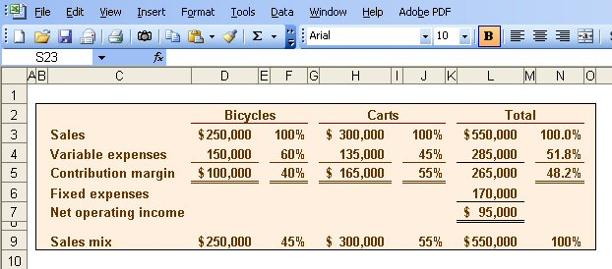
Multi-product break-even analysis
Racing Bicycle Co. provides the following information:
$265,000
$550,000
= 48.2% (rounded)
Notes:
Racing Bicycle sells both bikes and carts. Look at the contribution margin for each product. Notice that we subtract fixed expenses from the total contribution margin. We do not allocate the fixed costs to each product. The sales mix shows that 45% of the company’s sales revenue comes from the sale of bikes and 55% comes from the sale of carts. The combined contribution margin ratio is 48.2% (rounded). Let’s look at break-even.

Slide 54
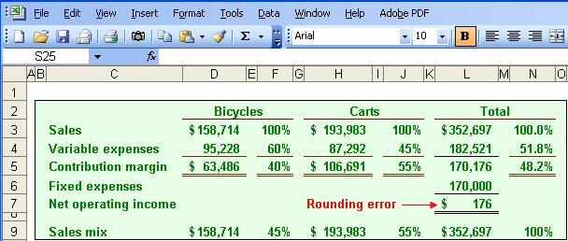
Multi-product break-even analysis
Break-even sales
Fixed expenses
CM Ratio
=
$170,000
48.2%
=
= $352,697
Notes:
Part I
Break-even in sales dollars is $352,697. We calculate this amount in the normal way. We divide total fixed expenses of $170,000 by the combined contribution margin ratio.
Part II
We begin by allocating total break-even sales revenue to the two products. 45% of the total is assigned to the bikes and 55% to the carts. The variable costs-by-product are determined by multiplying the variable expense percent times the assigned revenue. The contribution margin is the difference between the assigned revenue and the variable expenses. Once again, we subtract fixed expenses from the combined total contribution margin for the two products. Because we used a rounded contribution margin percent, we have a rounding error of $176. Obviously, the more products a company has, the more complex the break-even analysis becomes.

Slide 55
Key Assumptions of CVP Analysis
Selling price is constant.
Costs are linear.
In multiproduct companies, the sales mix is constant.
In manufacturing companies, inventories do not change (units produced = units sold).
Notes:
Here are the four key assumptions of cost-volume-profit analysis. You are probably familiar with the first three by now. The forth assumption tells us that there can be no change in inventory levels. That is, all units produced are sold in the current period.

